Slide 1
open cv
C++
Miri, Hodaya, Ateret

Slide 2
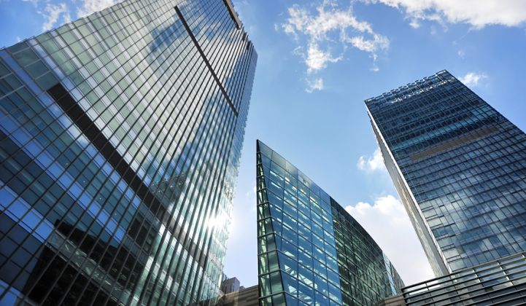
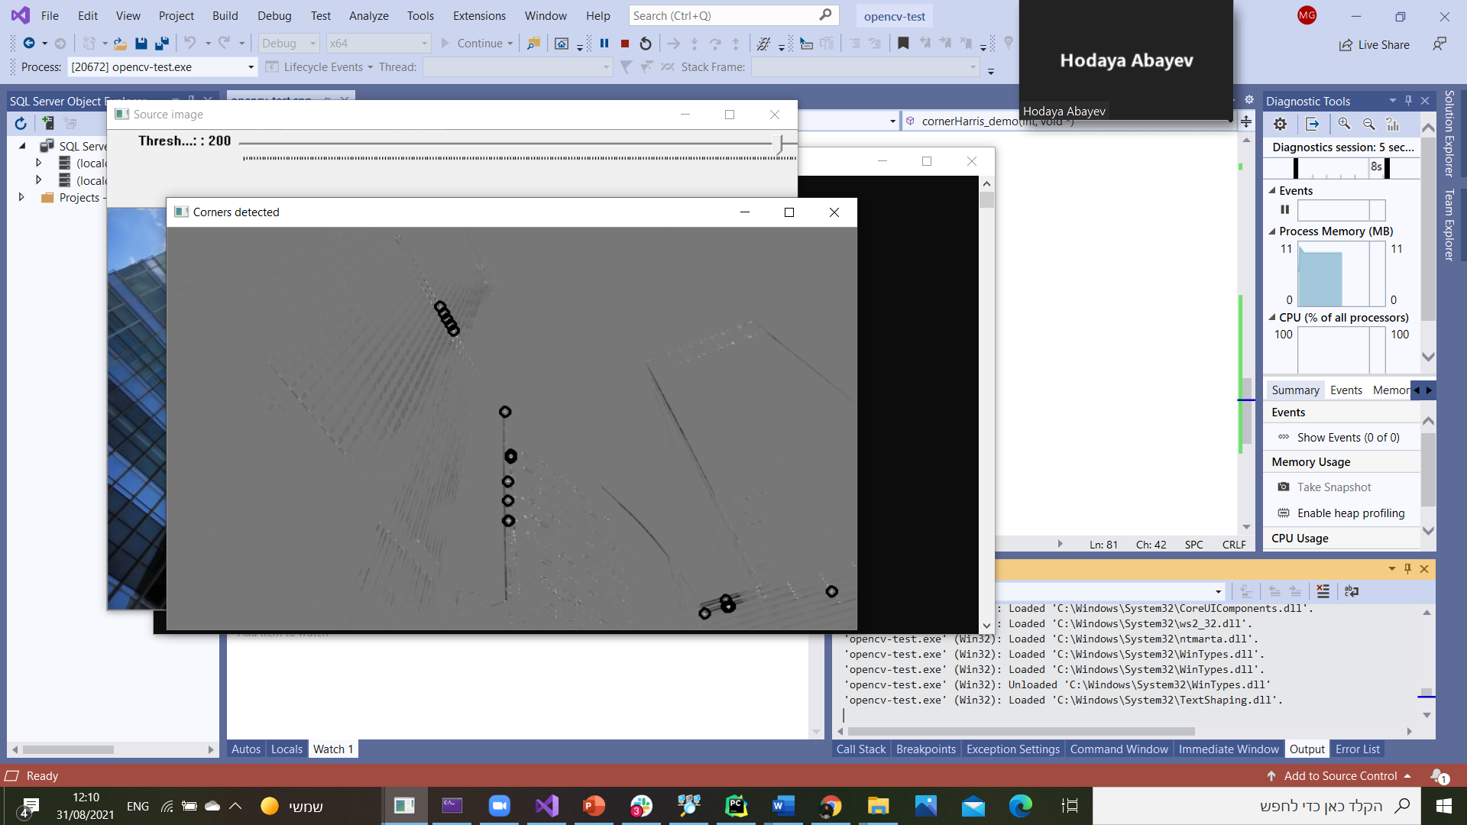
Harris corner detector
Detect corners using the Harris-Stephens method.
Before
After
cornerHarris: dst(x,y)=detM^(x,y)−k⋅(trM^(x,y))^2
src | Input single-channel 8-bit or floating-point image.
dst | Image to store the Harris detector responses. It has the type CV_32FC1 and the same size as src .
blockSize | Neighborhood size.
ksize | Aperture parameter for the Sobel operator.
k | Harris detector free parameter. See the formula above.
borderType | Pixel extrapolation method.

Slide 3
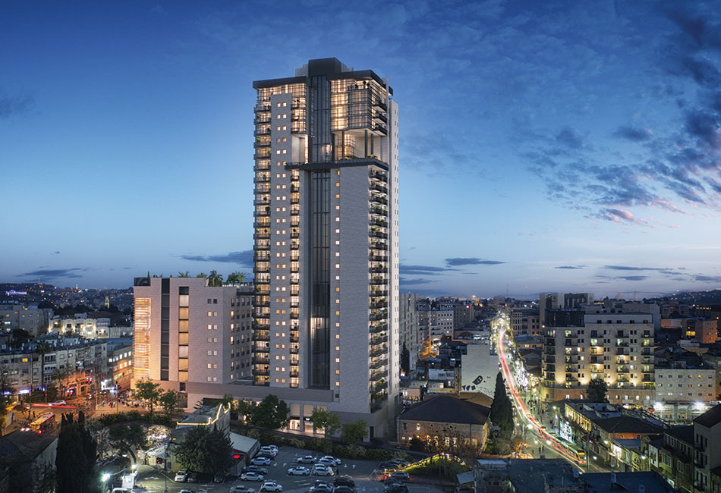
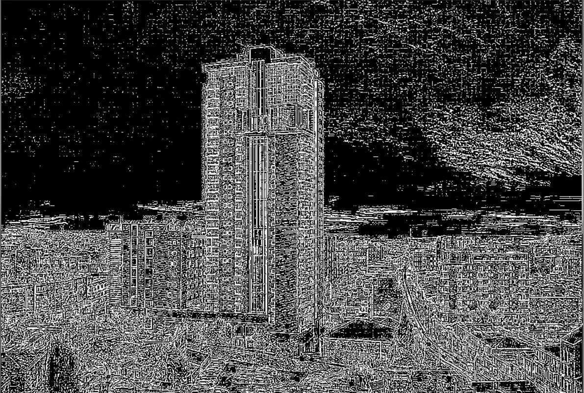
Implementing High Pass Filter
Implement high pass filter on an image
Before
After
The kernel used in this image is:
-1/9 | -1/9 | -1/9
-1/9 | 8/9 | -1/9
-1/9 | -1/9 | -1/9

Slide 4
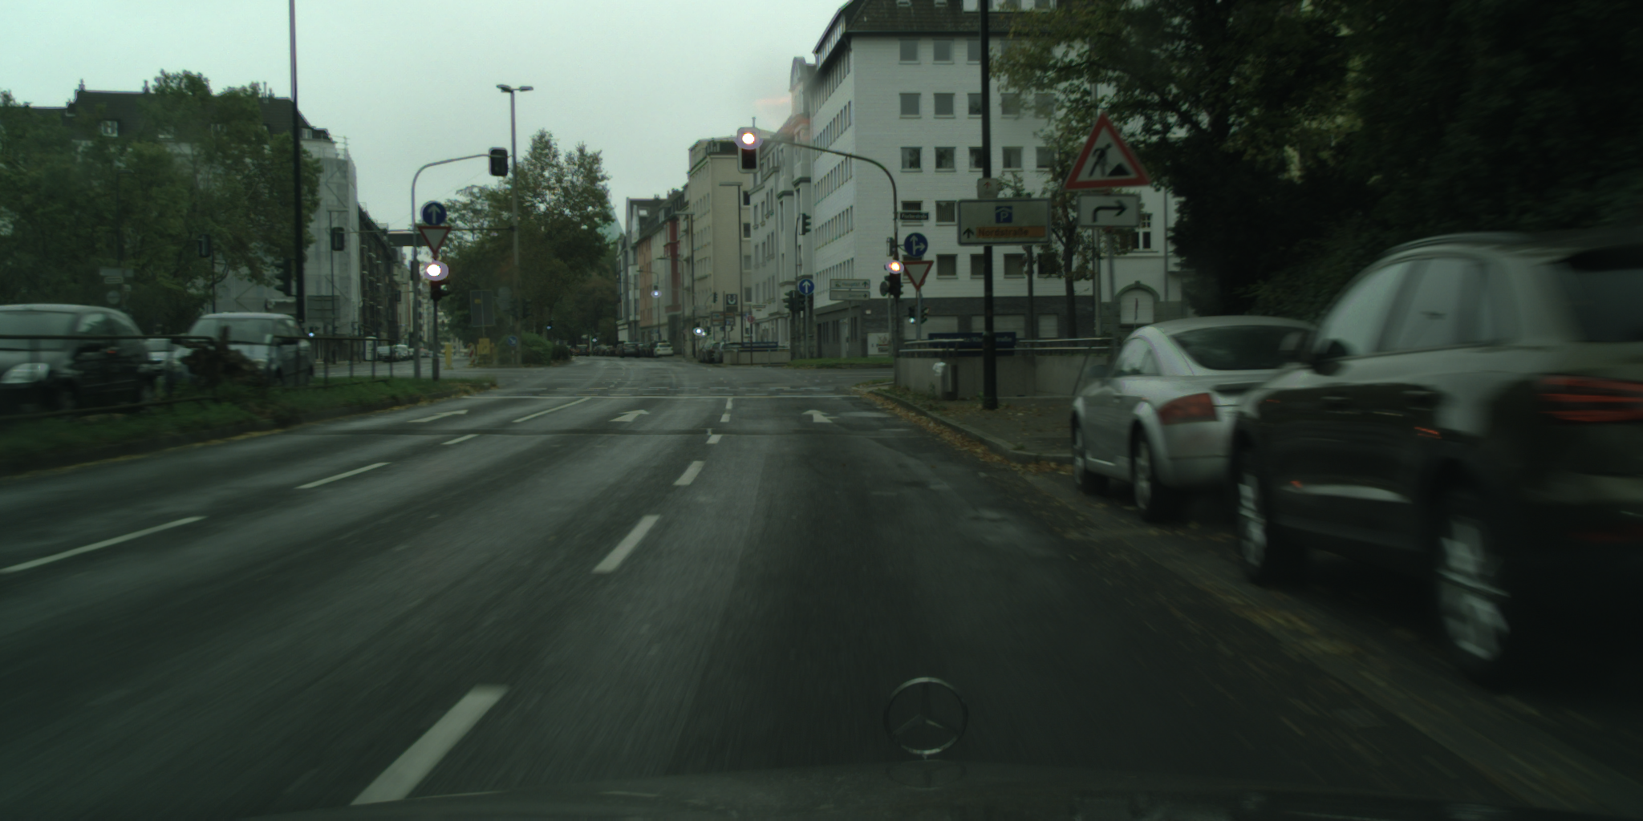
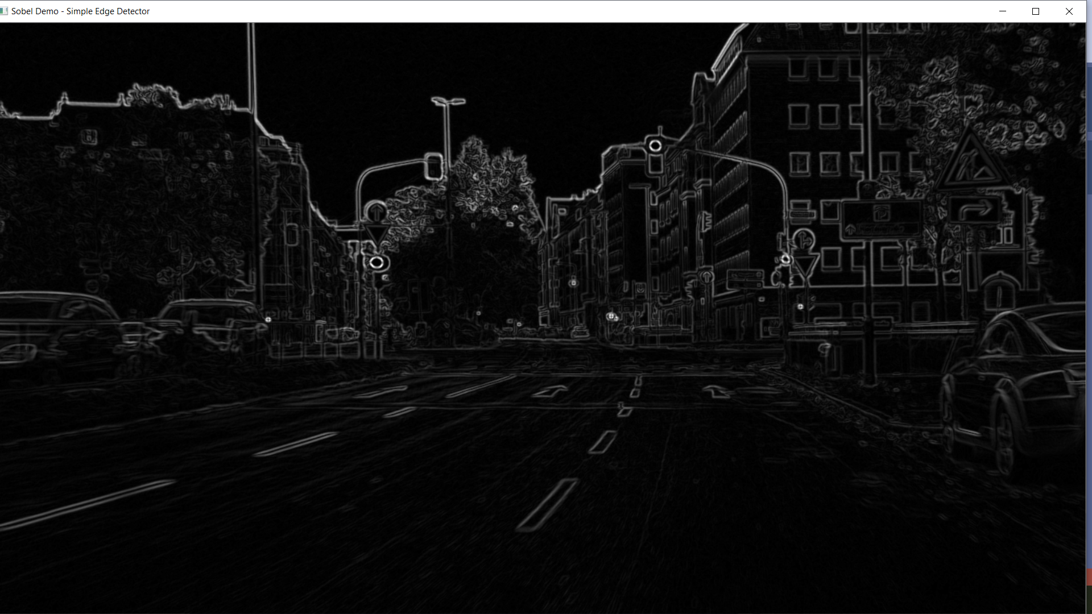
The Sobel Derivative
Calculates the first, second, third, or mixed image derivatives using an extended Sobel operator.
Applies the Sobel Operator and generates as output an image with the detected edges bright on a darker background.
Sobel(src_gray, dst, ddepth, dx, dy, ksize, scale, delta);
Before
After

Slide 5

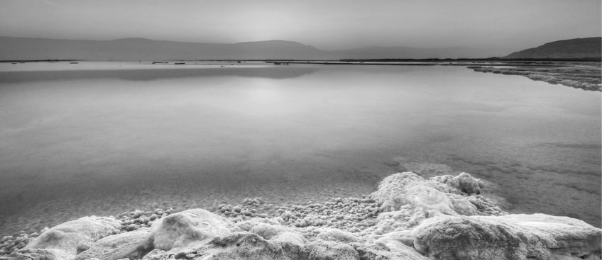
Implementing Low Pass Median Filter
removes the noise and blurs the edges
the Pixel's value get the median value of the mask
Before
After
Parameters:
a - mask size

Slide 6
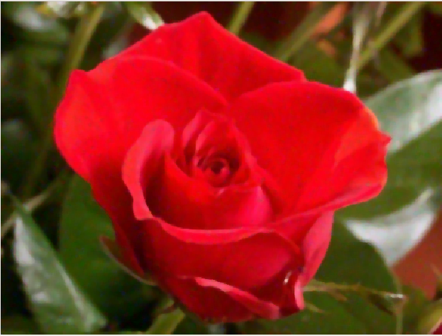
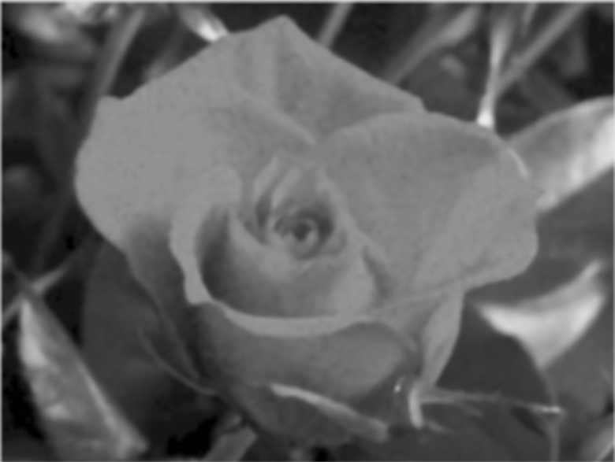
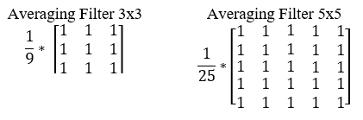
Low Pass Averaging Filter
removes the noise and blurs the edges
the Pixel's value get the Average value of the mask
Before
After

Slide 7
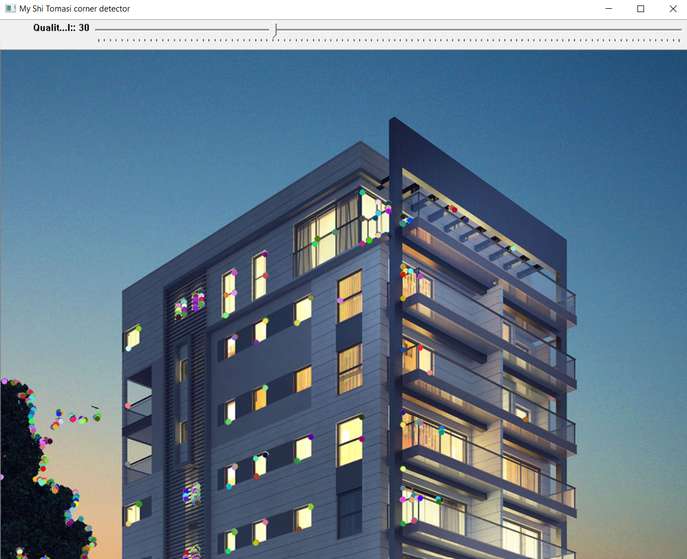
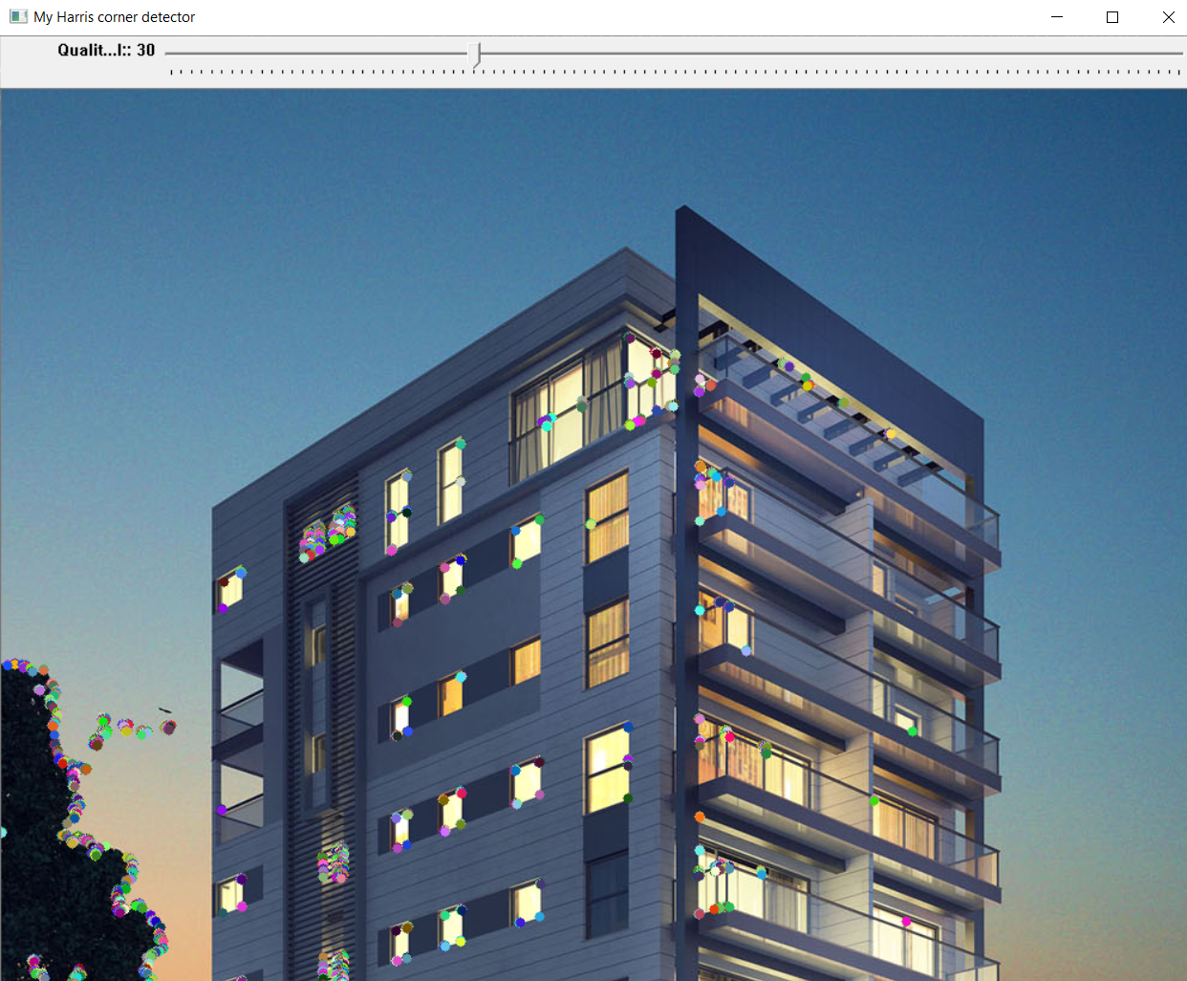
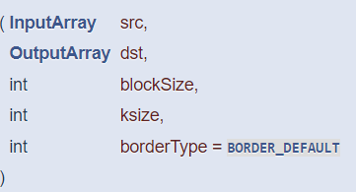
Creating your own corner detection
Implement our own version of the Harris detector as well as the Shi-Tomasi detector
My Shi Tomasi corner detection
My Harris corner detection

